Slide 1

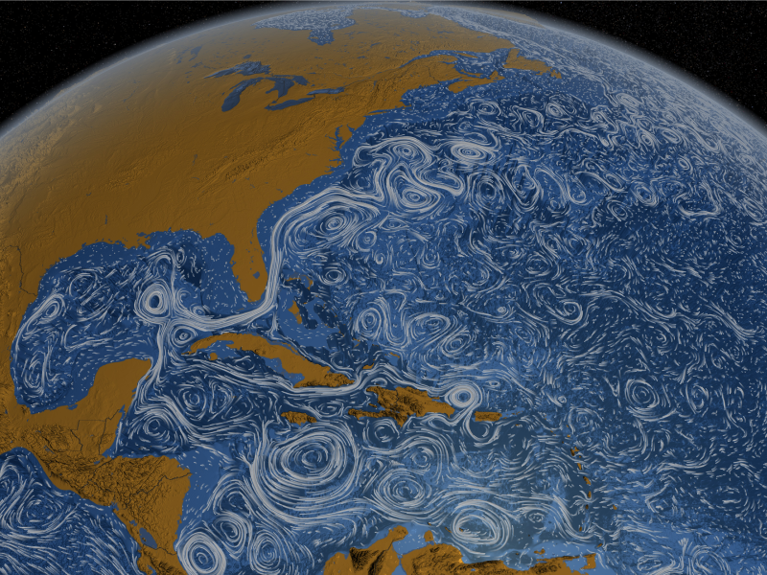
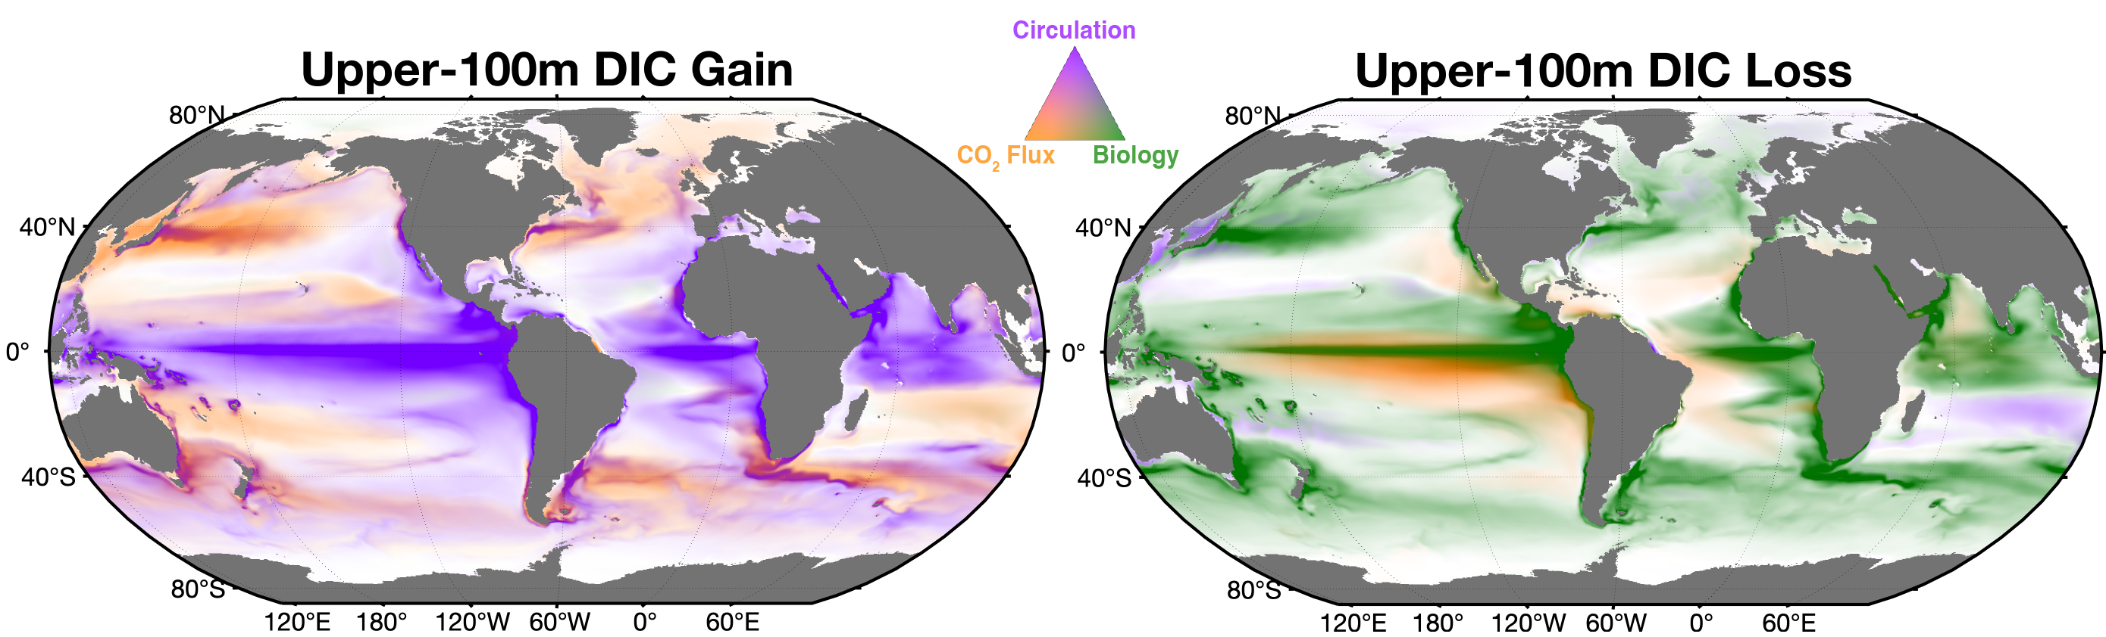
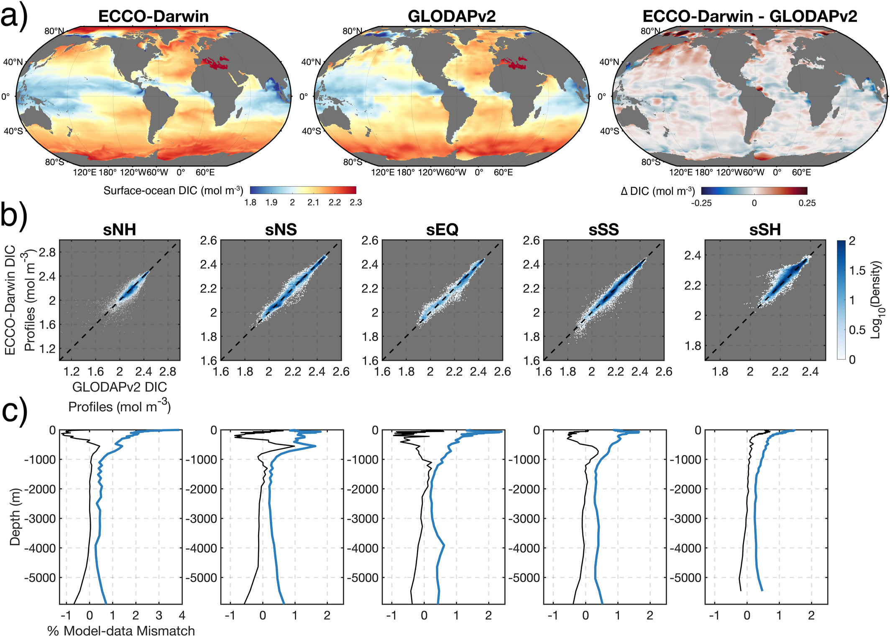
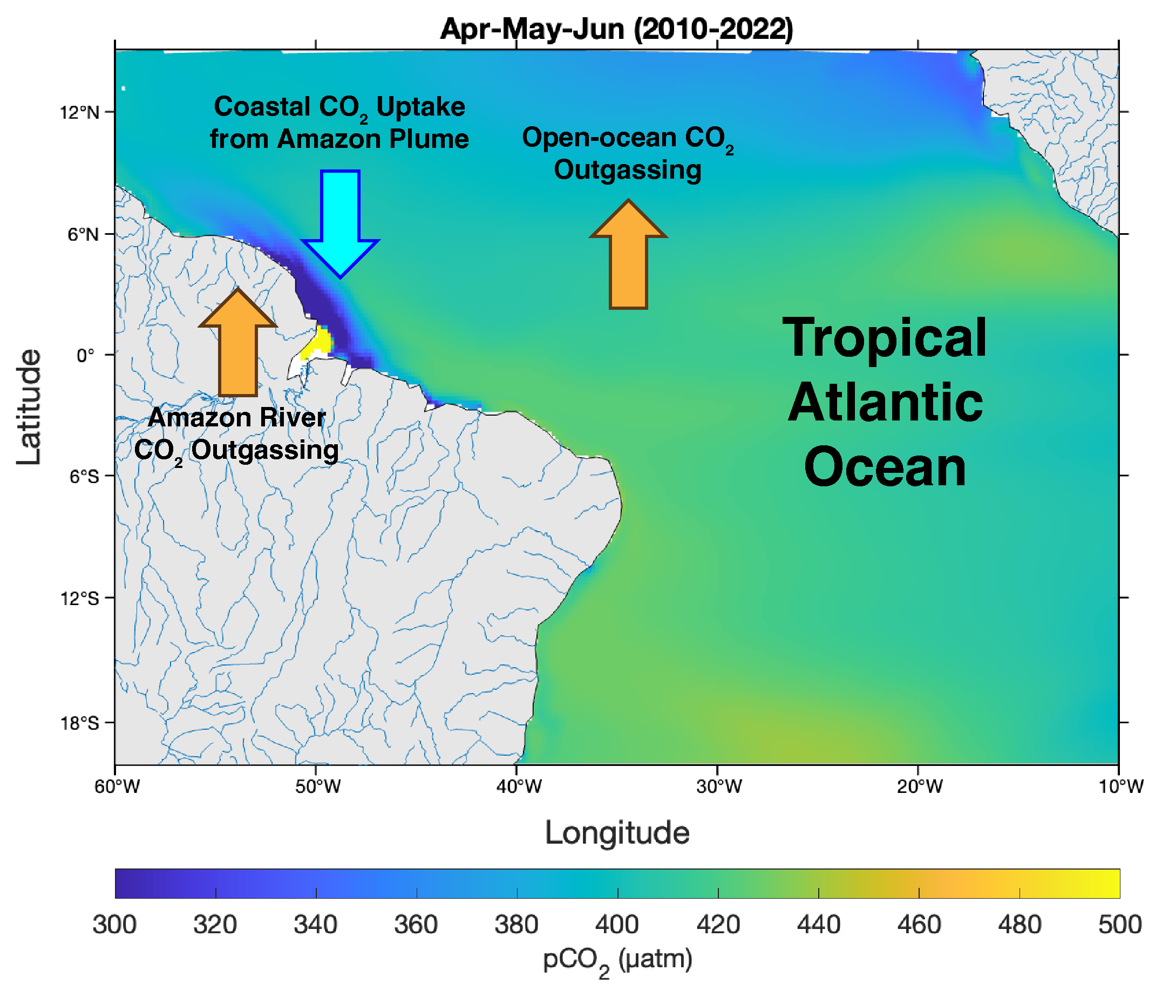
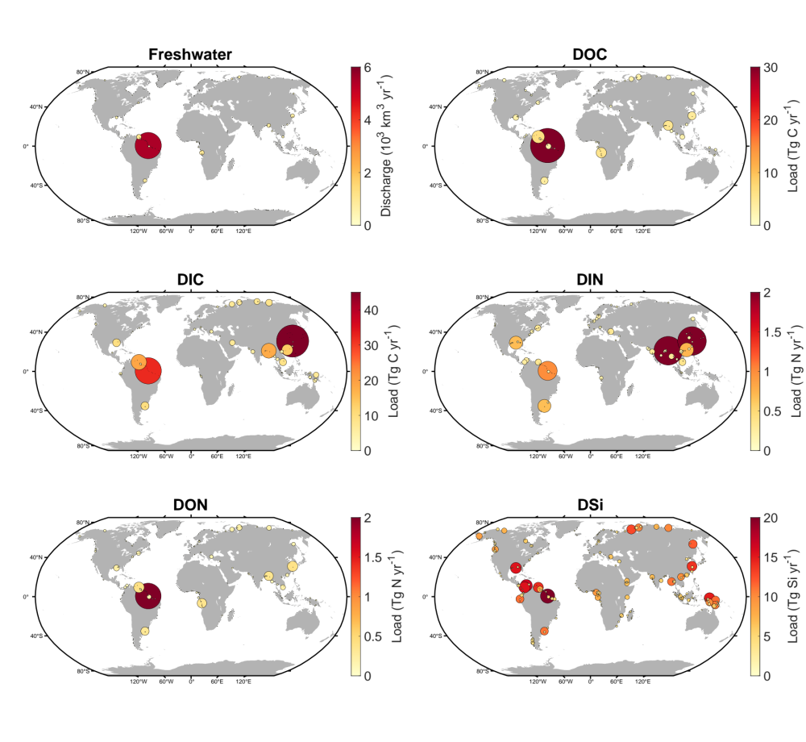
National Aeronautics and Space Administration
Postdoc Research
Monitoring Present-day Ocean Carbon in Response to Terrestrial Biogeochemical Fluxes with the ECCO-Darwin Model
Raphaël Savelli, JPL Postdoctoral Fellow (329B)
Dimitris Menemenlis (329B), Kyra Adams (329C), Dustin Carroll (MLML, SJSU)
The ECCO-Darwin Model
a) An Ocean Data-Assimilative Solution
Physical circulation and sea-ice based on the ECCO ocean state estimate
Realistic representation of ocean ecosystems
Radiative transfer through water column
b) Globally consistent with data-estimates of the ocean carbon biogeochemistry
c) A carbon monitoring solution
Source: NASA/Goddard Space Flight Center Scientific Visualization Studio
Ocean DIC concentration. Carroll et al. (2022), GBC.
Attribution of space-time variability in global-ocean DIC. Carroll et al. (2022), GBC.
Land-to-Ocean fluxes in ECCO-Darwin
a) Monthly diffuse terrestrial freshwater discharge
b) Biogeochemical runoff only in regional-scale solutions
In this study, we introduce a new method to combine daily point-source freshwater and annual watershed biogeochemical runoff:
 | Model | Period | Grid | Variables of interest
Daily discharge | JRA55-do | 1958–present | 55 km | Freshwater runoff
Annual carbon and nutrient discharge | Global NEWS 2 | Year 2000 | Point | Dissolved organic and inorganic nutrients (C, N, Si)
Surface-ocean pCO₂ in Tropical Atlantic.
Castro-Morales et al. (in prep).
Objective
Quantifying the impact of terrestrial carbon and nutrients in ocean carbon biogeochemistry using the ECCO-Darwin framework
1) Compute Land-to-Ocean fluxes
Contrasting patterns in C/nutrient discharge:
Arctic and Tropical Atlantic are dominated by dissolved carbon
Southeast Asia is dominated by dissolved inorganic nitrogen
2) Quantify associated change in air-sea CO₂ fluxes
Summary
Including riverine C/nutrients generally increases ocean CO₂ outgassing:
Global: +1.5% (+0.03 Pg C yr-1)
Arctic Ocean: +10%
Tropical Atlantic: +20%
Southeast Asia: -9%
3) Identify respective role of carbon and nutrients
Riverine carbon and nitrogen play different roles in ocean biogeochemistry:
C runoff drives more CO₂ outgassing through solubility pump
N runoff drives more ingassing through primary production
National Aeronautics and Space Administration
Jet Propulsion Laboratory
California Institute of Technology
Pasadena, California
www.nasa.gov
Publications:
R. Savelli, D. Carroll, D. Menemenlis, J. Lauderdale, S. Dutkiewicz, M. Manizza, A. Bloom, K. Castro-Morales, C. E. Miller, M. Simard, K. W. Bowman, H. Zhang, (in revisions), Monitoring Present-day Ocean Carbon Cycling Response to Terrestrial Biogeochemical Fluxes with the ECCO-Darwin Data-Assimilative Global Ocean Biogeochemistry Model. JAMES.
Author Contact Information:
818-354-4768 | raphael.savelli@jpl.nasa.gov
Poster Number: PRD-E-017
Clearance Number:
Copyright 2024. All rights reserved.

